Slide 1


5. Operating System
Notes:
NOTE:
To change the image on this slide, select the picture and delete it. Then click the Pictures icon in the placeholder to insert your own image.

Slide 2
Content
5.1 Introduction
5.2 Evolution
5.3 Components of OS: UI, memory manager, process manager, file manager, device manager
5.4 Components of OS: UI, memory manager, process manager, file manager, device manager (continue)

Slide 3
Objectives
After studying this chapter, the student should be able to:
Understand the role of the operating system.
Understand the process of bootstrapping to load the operating system into memory.
List the components of an operating system.
Discuss the role of the memory manager.
Discuss the role of the process manager.
Discuss the role of the device manager.
Discuss the role of the file manager in an operating system.
Understand the main features of three common operating systems: UNIX, Linux and Windows.

Slide 4
1-Introduction

Slide 5
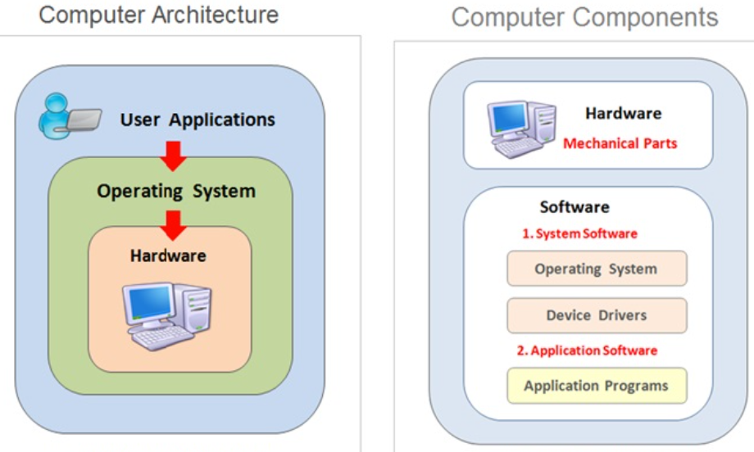
1. Introduction
A computer is a system composed of two major components: hardware and software. Computer hardware is the physical equipment.
Software is the collection of programs that allows the hardware to do its job. Computer software is divided into two broad categories: the operating system and application programs.
Application programs use the computer hardware to solve users’ problems. The operating system, on the other hand, controls the access to hardware by users
Figure 5.1 Computer system

Slide 6
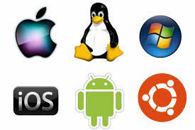
Operating System
An operating system is complex, so it is difficult to give a simple universal definition. Instead, here are some common definitions:
❑ An operating system is an interface between the hardware of a computer and the user (programs or humans).
❑ An operating system is a program (or a set of programs) that facilitates the execution of other programs.
An operating system acts as a general manager supervising the activity of each component in the computer system.
Two major design goals of an operating system are:
❑ Efficient use of hardware.
❑ Ease of use of resources.
Figure 5.2 Operating systems

Slide 7
Bootstrap Process
The operating system provides supports for other programs. For example, it is responsible for loading other programs into memory for execution. However, the operating system itself is a program that needs to be loaded into the memory and be run. How is this dilemma solved?
The solution is a two-stage process. A very small section of memory is made of ROM and holds a small program called the bootstrap program.
When the computer is turned on, the CPU counter is set to the first instruction of this bootstrap program and executes the instructions in this program.
When loading is done, the program counter is set to the first instruction of the operating system in RAM.
Figure 5.3 Bootstrap Process

Slide 8
2 - EVOLUTION

Slide 9
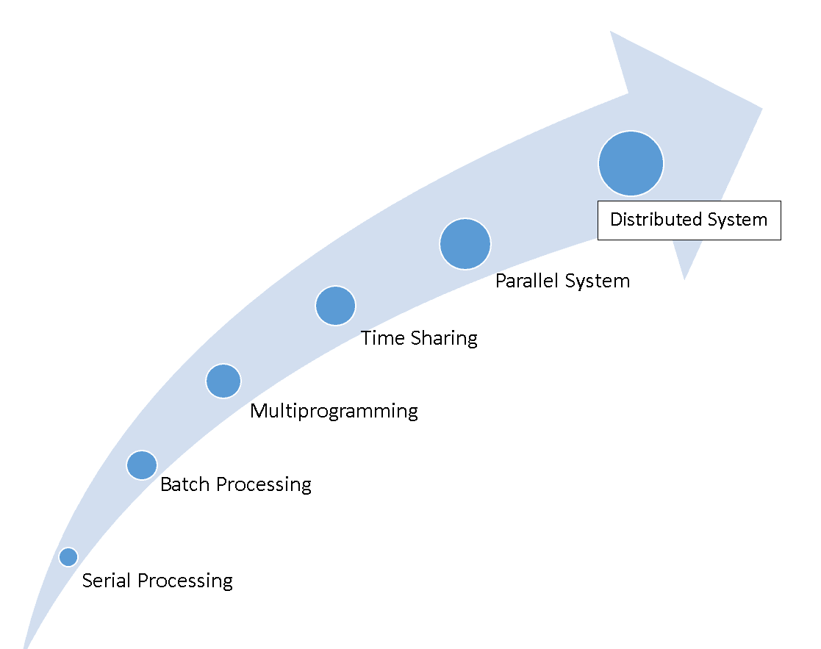
Overview
Figure 5.3 Evolution of Operating systems

Slide 10
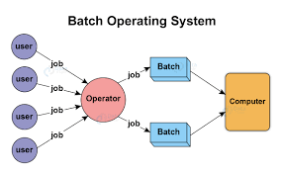
Batch systems
Batch systems Batch operating systems were designed in the 1950s to control mainframe computers. At that time, computers were large machines that used punched cards for input, line printers for output and tape drives for secondary storage media. Each program to be executed was called a job. A programmer who wished to execute a job sends a request to the operating system.
Figure 5.4 Structure of Batch operating systems

Slide 11
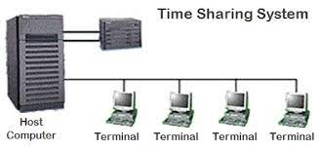
Time-sharing systems
Time-sharing systems To use computer system resources efficiently, multiprogramming was introduced. The idea is to hold several jobs in memory at a time, and only assign a resource to a job that needs it on the condition that the resource is available. Multiprogramming brought the idea of time sharing: resources could be shared between different jobs, with each job being allocated a portion of time to use a resource.
Figure 5.5 Structure of Time-sharing operating systems

Slide 12
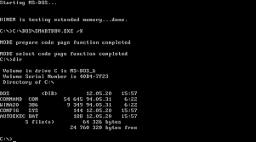
Personal systems
Personal systems When personal computers were introduced, there was a need for an operating system for this new type of computer.
During this era, single-user operating systems such as DOS (Disk Operating System) were introduced.
Figure 5.6 DOS system

Slide 13
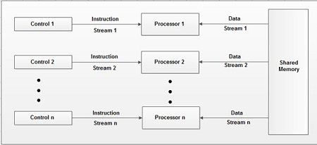
Parallel systems
Parallel systems The need for more speed and efficiency led to the design of parallel systems: multiple CPUs on the same machine.
Each CPU can be used to serve one program or a part of a program, which means that many tasks can be accomplished in parallel instead of serially. The operating systems required for this are more complex than those that support single CPUs.
Figure 5.7 Structure of Parallel operating systems

Slide 14
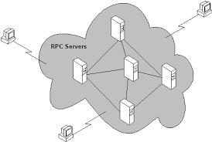
Distributed systems
Distributed systems Networking and internetworking, as we saw in Chapter 6, have created a new dimension in operating systems.
A job that was previously done on one computer can now be shared between computers that may be thousands of miles apart. Distributed systems combine features of the previous generation with new duties such as controlling security.
Figure 5.8 Structure of Distributed operating systems

Slide 15
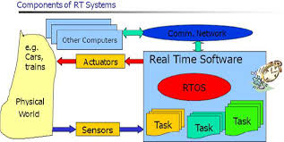
Real-time systems
Real-time systems (RTOS) A real-time system is expected to do a task within a specific time constraint.
They are used with real-time applications, which monitor, respond to or control external processes or environments.
Figure 5.9 A real-time system

Slide 16
3- Components of OS

Slide 17
Introduction
Today’s operating systems are very complex. An operating system needs to manage different resources in a computer system. It resembles an organization with several managers at the top level. Each manager is responsible for managing their department, but also needs to cooperate with others and coordinate activities.
A modern operating system has at least four duties: memory manager, process manager, device manager and file manager.
Figure 5.10 Components of an operating system

Slide 18

3.1 User interface
Each operating system has a user interface, a program that accepts requests from users (processes) and interprets them for the rest of the operating system.
A user interface in some operating systems, such as UNIX, is called a shell. In others, it is called a window to denote that it is menu driven and has a GUI (graphical user interface) component.
Figure 5.11 Sample UI

Slide 19
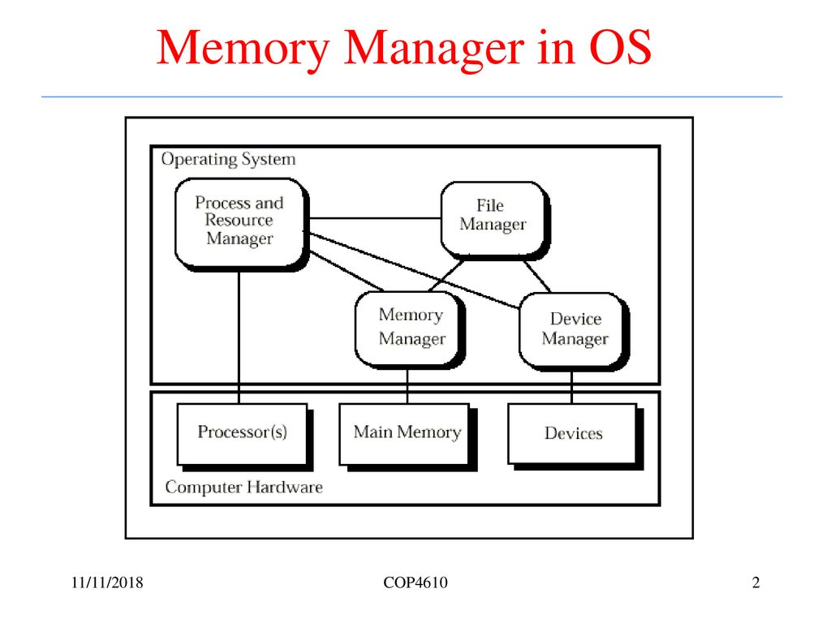
3.2 Memory manager
One of the responsibilities of a modern computer system is memory management. Although the memory size of computers has increased tremendously in recent years, so has the size of the programs and data to be processed.
Memory allocation must be managed to prevent applications from running out of memory. Operating systems can be divided into two broad categories of memory management: monoprogramming and multiprogramming.
Figure 5.12 Memory manager in OS

Slide 20
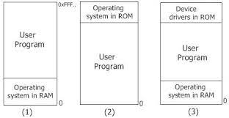
Monoprogramming
In monoprogramming, most of the memory capacity is dedicated to a single program; only a small part is needed to hold the operating system.
In this configuration, the whole program is in memory for execution. When the program finishes running, the program area is occupied by another program.
Figure 5.13 Memory manager in OS

Slide 21
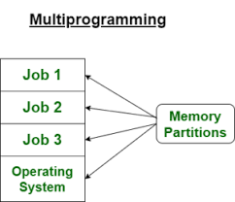
Multiprogramming
In multiprogramming, more than one program is in memory at the same time, and they are executed concurrently, with the CPU switching rapidly between the programs.
Figure 5.14 Memory manager in OS

Slide 22
Categories of multiprogramming
Figure 5.15 Memory manager in OS

Slide 23
Categories of multiprogramming (cont)
Figure 5.16 Memory manager in OS

Slide 24
Virtual memory
Demand paging and demand segmentation mean that, when a program is being executed, part of the program is in memory and part is on disk. This means that, for example, a memory size of 10 MB can execute 10 programs (each of size 3 MB). At any moment, 10 MB of the 10 programs are in memory and 20 MB are on disk.
Therefore a virtual memory size of 30 MB. Virtual memory, which implies demand paging, demand segmentation or both, is used in almost all operating systems today.
Figure 5.17 Memory manager in OS

Slide 25
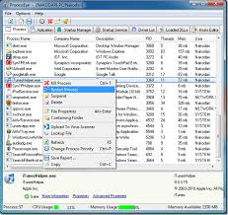
3.3 Process manager
A second function of an operating system is process management, but before discussing this concept, we need to define some terms.
Program, job, and process
❑ A program is a non-active set of instructions stored on disk.
❑ A program becomes a job from the moment it is selected for execution until it has finished running and becomes a program again.
❑ A process is a program in execution. It is a program that has started but has not finished.
Figure 5.18 Windows 7 system process manager

Slide 26
State diagrams & Queuing
State diagrams
The relationship between a program, a job and a process becomes clearer if we consider how a program becomes a job and how a job becomes a process
Queuing
To handle multiple processes and jobs, the process manager uses queues (waiting lists). A job control block or process control block is associated with each job or process. This is a block of memory that stores information about that job or process. The process manager stores the job or process control block in the queues instead of the job or process itself.

Slide 27
Process synchronization
The whole idea behind process management is to synchronize different processes with different resources. Whenever resources can be used by more than one user (or process, in this case), we can have two problematic situations: deadlock and starvation.
Figure 5.19 Deadlock in OS

Slide 28
Process synchronization (cont)
Figure 5.20 Starvation in OS

Slide 29
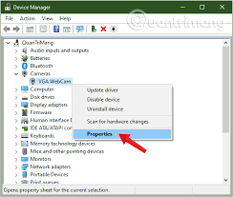
3.4 Device manager
The device manager, or input/output manager, is responsible for access to input/ output devices. There are limitations on the number and speed of input/output devices in a computer system.
❑ The device manager monitors every input/output device constantly to ensure that the device is functioning properly.
❑ The device manager maintains a queue for each input/output device or one or more queues for similar input/output devices.
❑ The device manager controls the different policies for accessing input/output devices.
Figure 5.21 Windows 7 system divice manager

Slide 30
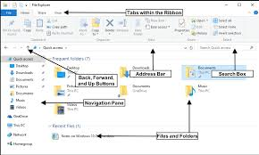
3.5 File manager
Operating systems today use a file manager to control access to files. A detailed discussion of the file manager also requires advanced knowledge of operating system principles and file access concepts that are beyond the scope of this book. The file manager:
❑ controls access to files.
❑ supervises the creation, deletion, and modification of files.
❑ controls the naming of files.
❑ supervises the storage of files.
❑ is responsible for archiving and backups.
Figure 5.22 Windows 10 file explorer

Slide 31
A SURVEY OF OPERATING SYSTEMS (UNIX)
UNIX was originally developed in 1969 by Thomson and Ritchie of the Computer Science Research Group at Bell Laboratories.
UNIX has been a popular operating system among computer programmers and computer scientists.
UNIX is a multiuser, multiprocessing, portable operating system. It is designed to facilitate programming, text processing and communication
Figure 5.23 Component of UNIX

Slide 32
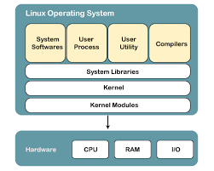
A SURVEY OF OPERATING SYSTEMS (LINUX)
Linux In 1991, Linus Torvalds, a Finish student at the University of Helsinki at the time, developed a new operating system that is known today as Linux.
The initial kernel, which was similar to a small subset of UNIX, has grown into a full-scale operating system today.
The Linux 2.0 kernel, released in 1997, was accepted as a commercial operating system: it has all features traditionally attributed to UNIX
Figure 5.24 Component of UNIX

Slide 33
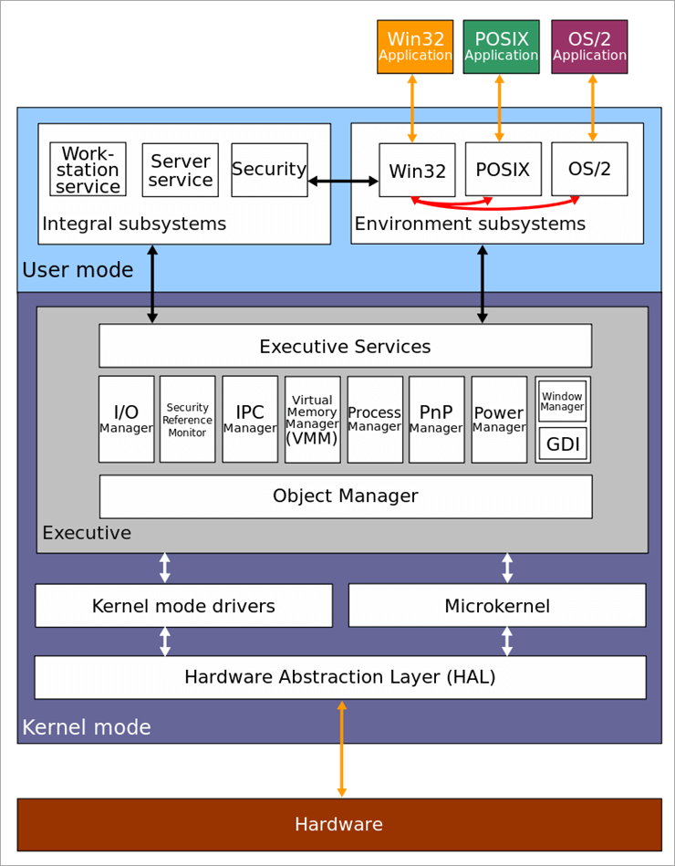
A SURVEY OF OPERATING SYSTEMS (WINDOWS)
Windows In the late 1980s Microsoft, under the leadership of Dave Cutler, started development of a new single-user operating system to replace MS-DOS (Microsoft Disk Operating System).
Several versions of windows are followed, such as Windows NT (NT standing for New Technology), Windows 2000, Windows XP (XP stands for eXPerience in 2001), Windows 7 (supports the functions for touch-controlled screen and has released this year of 2009), Windows 8/8.1, Windows 10, and so on.
Figure 5.25 Component of Window

